Slide 1
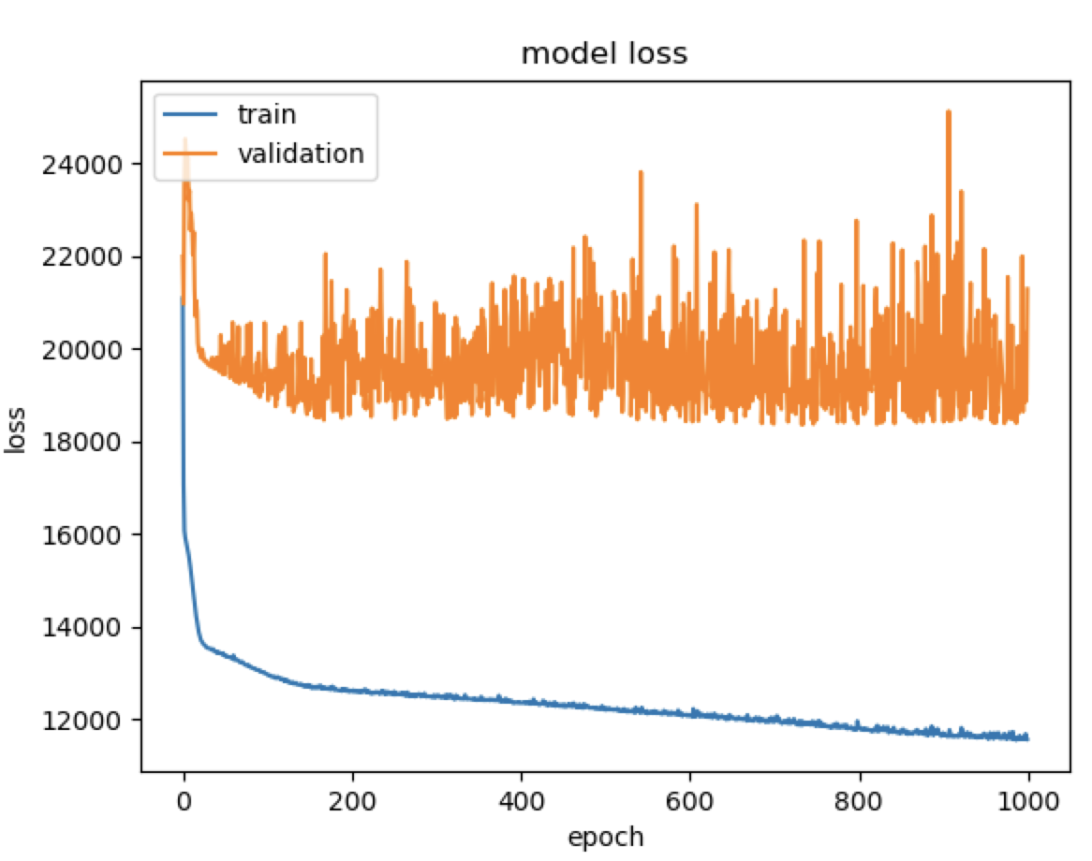
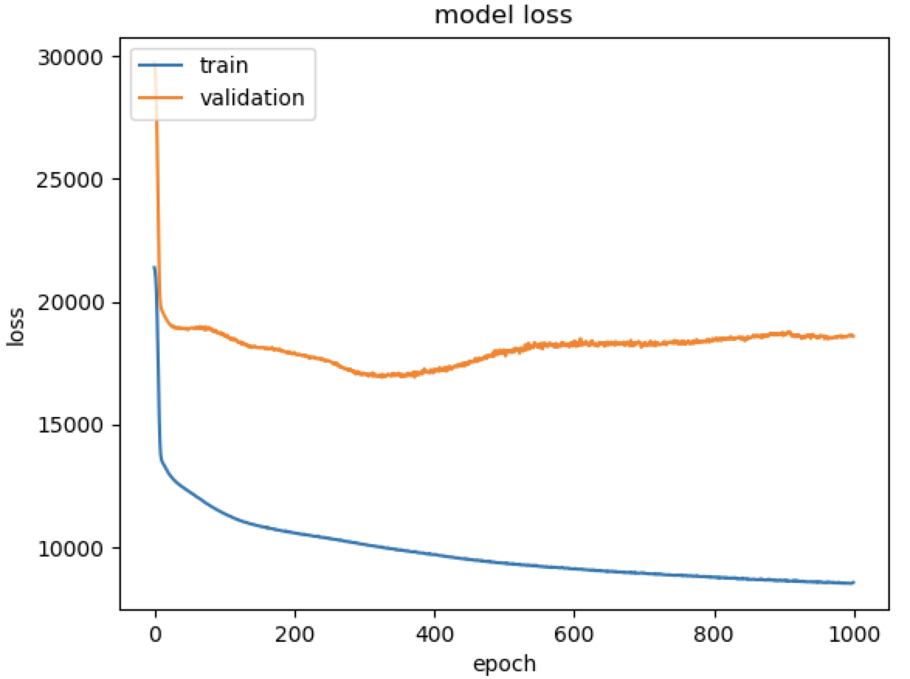
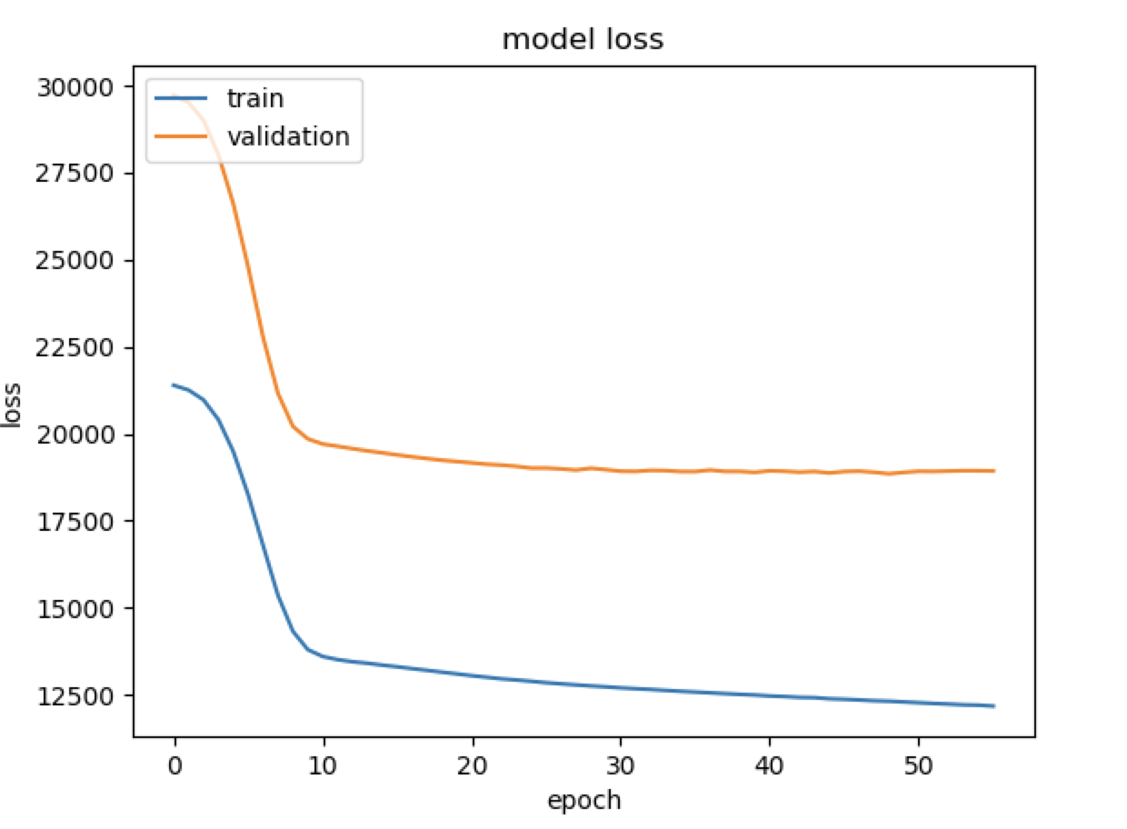

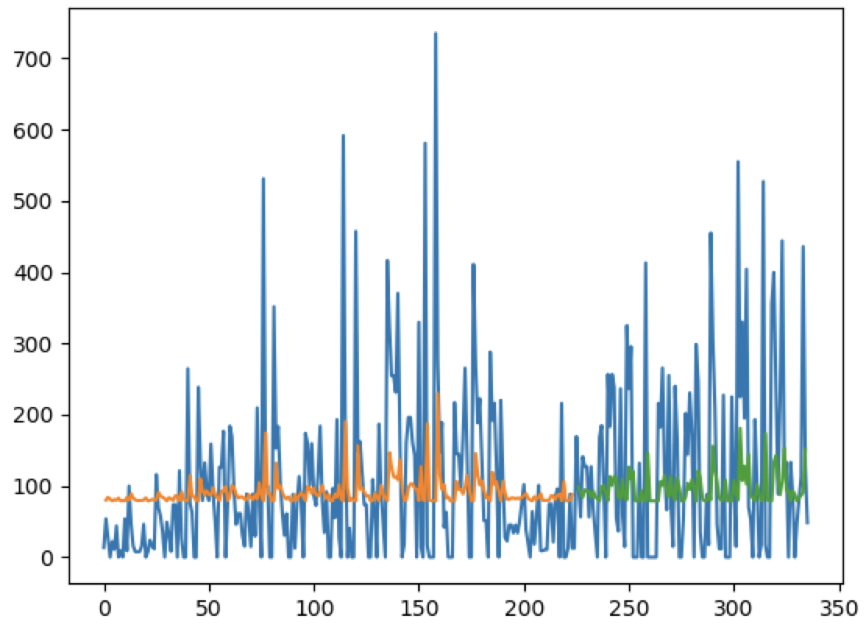
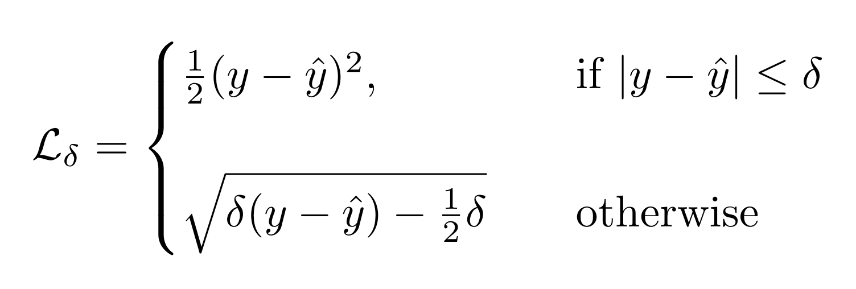
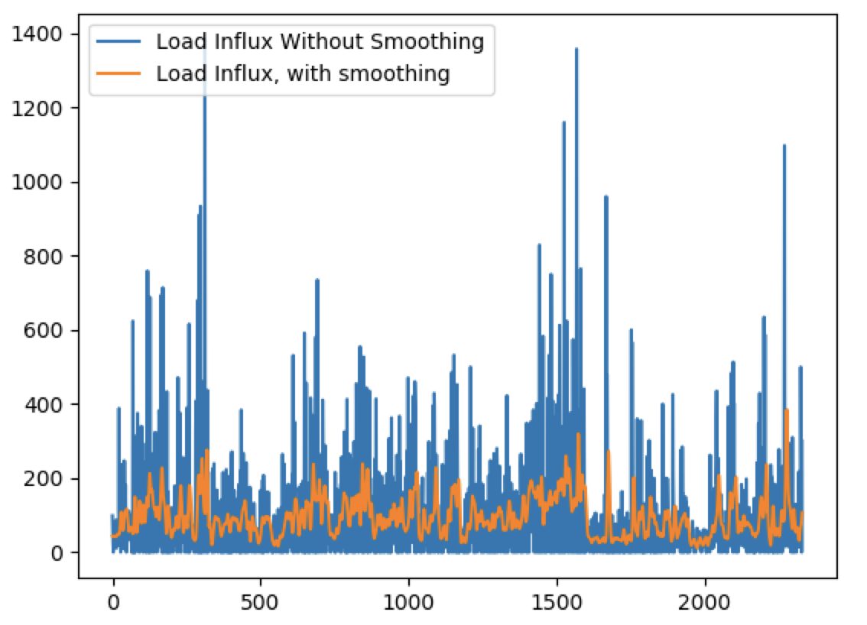
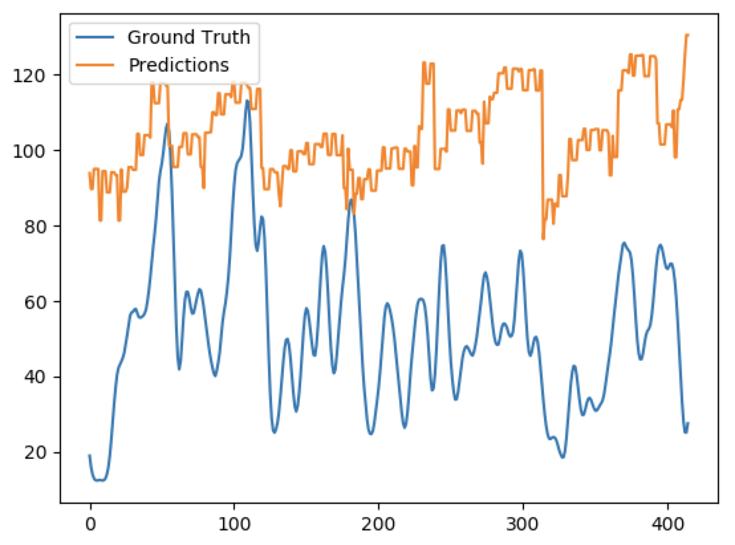
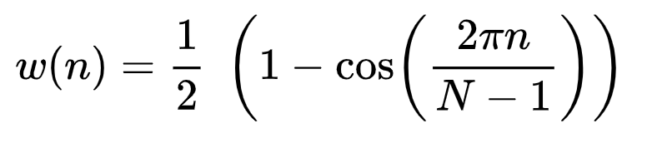
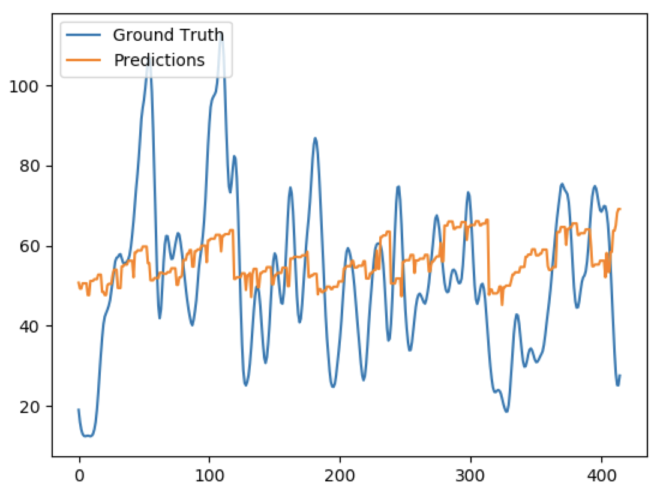
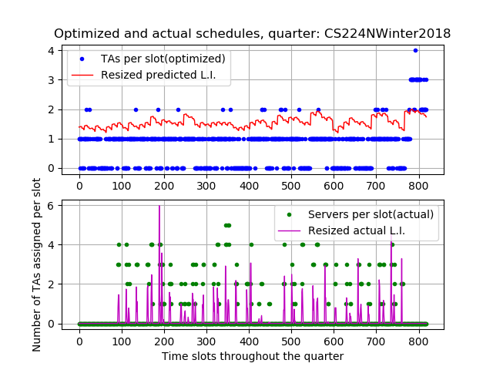
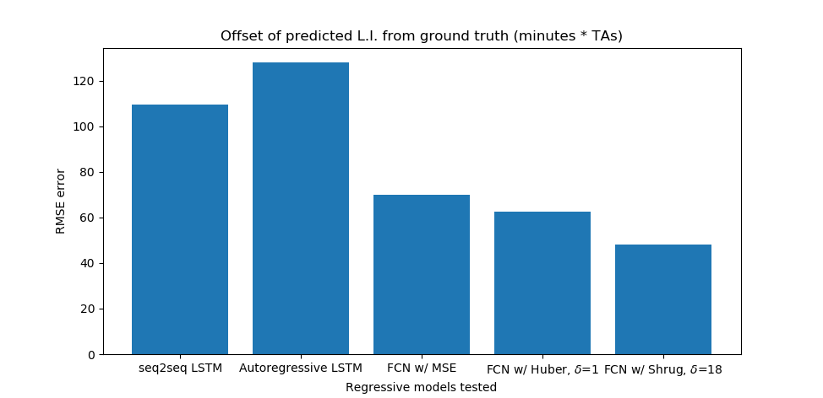
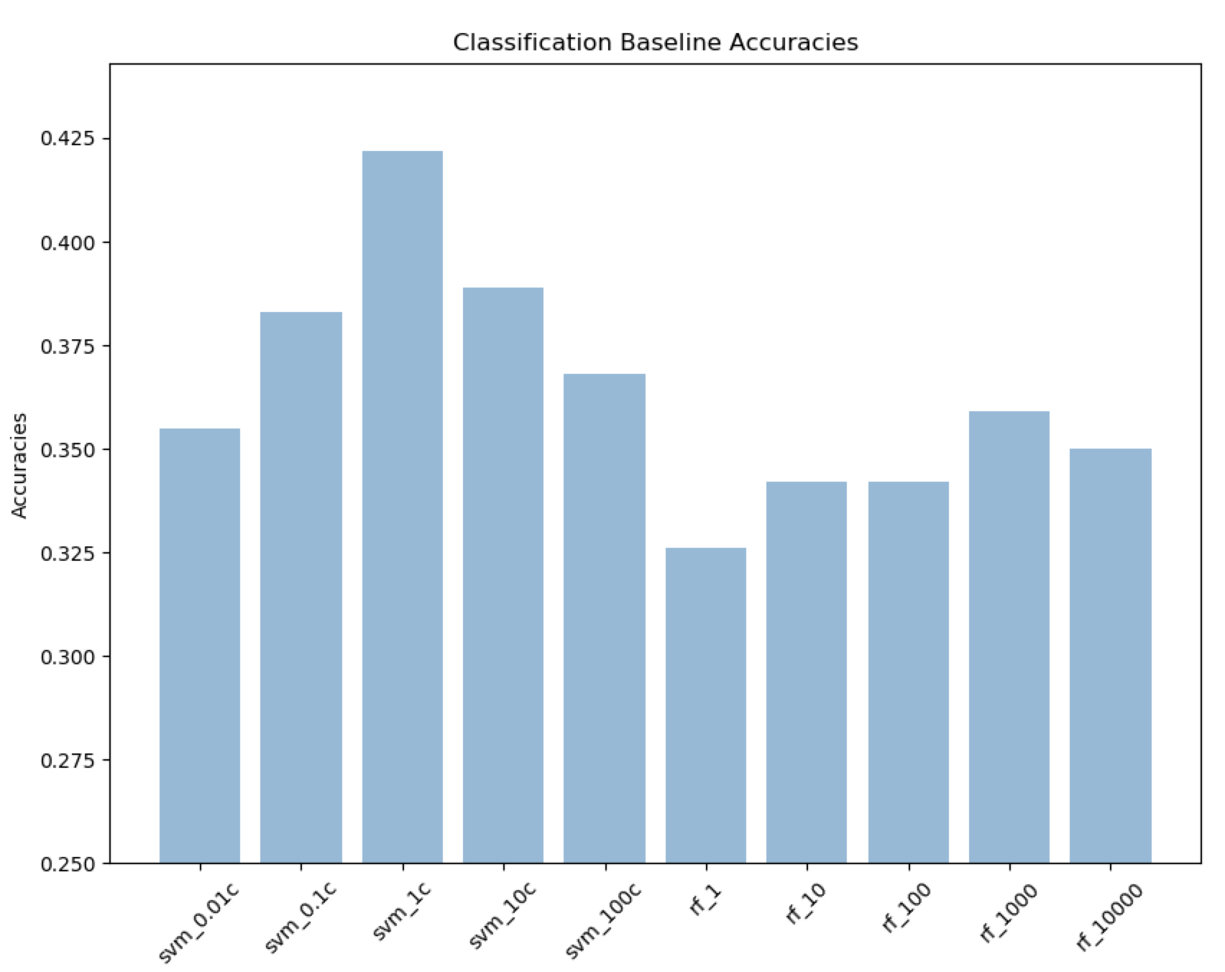
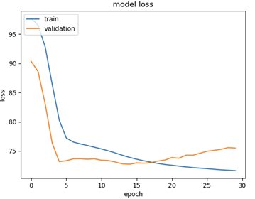
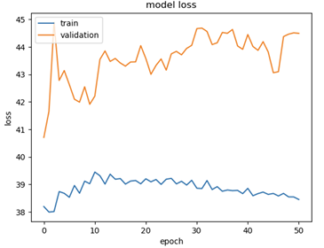
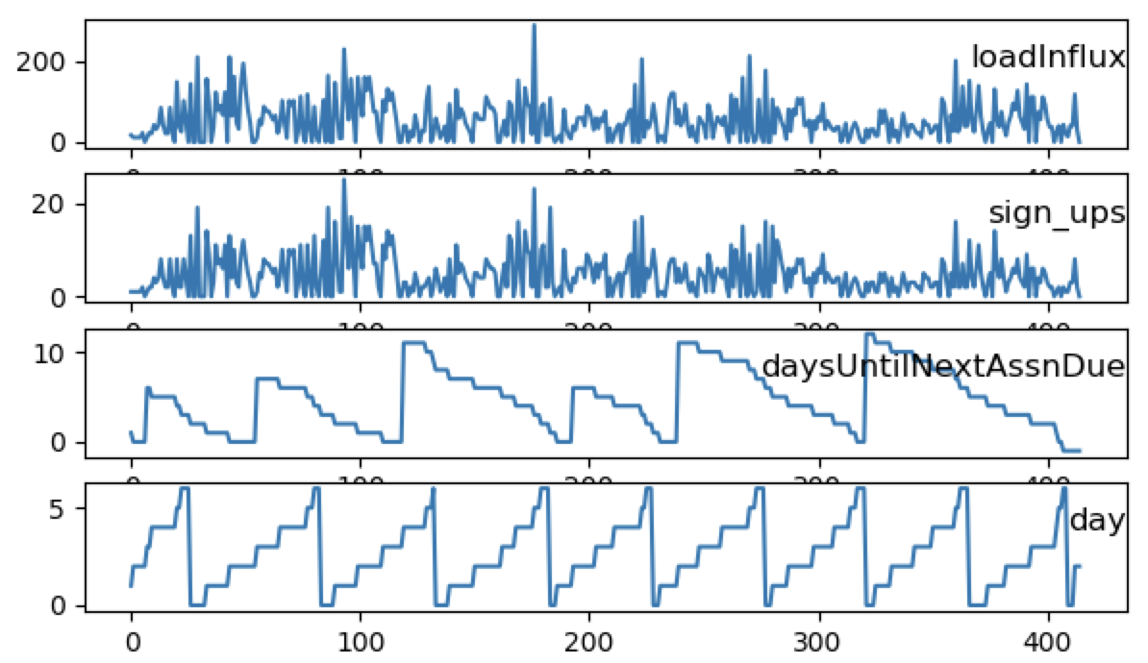
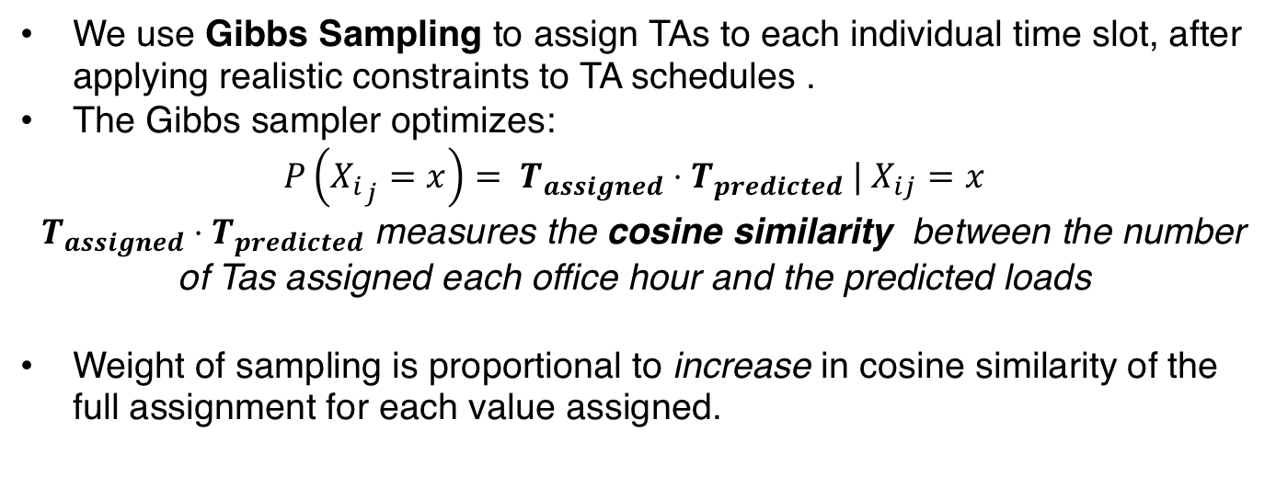
Without norm With normalization Norm + Early stopping
Deep Queue-Learning: A Quest to Optimize Office Hours
CS 221
Avoy Datta, Dian Ang Yap, Zheng Yan
CS 229 | Autumn 2018
Note: This project was a joint product of work done for CS221 and CS229.
CS 229
Initial mode (Univariate LSTM) predicts load influx spikes. (Blue- actual, orange – train predictions, green– validation predictions). Y-axis is the load influx, X-axis represents OH timeslots in chronological order.
Introduction
Methodology
Results
OHs often suffer from overcrowding and long wait times, stressing both students and instructors.
If we could accurately predict the expected workload at a given OH, TAs can be better allocated. However, not much work has been done in this regard. [1]
QueueStatus, Carta, and course syllabi provide a wealth of information that can be used. We scraped 9AM-8PM hourly data for a total of 15 quarters’ of classes, where each row contains the average serve time, number of signups, and other information regarding the hour and class.
We trained a neural network model that predicts student load influx (expected serve time * # sign-ups) at OH on an hourly basis, for any course, using features as described below.
With these predictions, we can optimize TA scheduling given realistic constraints.
We defined a new loss (Shrug loss) and used smoothing on labelled data to reduce penalty on outliers.
To reduce contributions by outliers, we smooth out the data through convolution with a Hann window:
Visualization of smoothed y-labels
Shrug loss reduces offset of predictions
MSE, with smoothing
Experiments
Smoothing reduces spikes in erratic data.
Less effective in predicting actual magnitude.
Shrug, with smoothing
Both classification (SVMs, Random Forest) and regression (fully connected nets, LSTMs) were experimented for predictions.
Cosine similarity, actual schedule | Cosine similarity, optimized schedule
0.794 | 0.789
Class Statistics
Table 1: Statistics for sample of classes (4/12 shown)
Loss Functions w/ FCN | Train RMSE (Load Influx) | Test RMSE (Load Influx)
MSE | 41.1 | 78.1
MAE | 41.2 | 72.5
Huber (𝛿 = 1) | 41.2 | 72,6
Shrug (𝛿 = 18) | 44.6 | 62.7
Class | Quarter & Year | #OH-Active TAs | Total # Students | Total OH Hours | Total Served | Total Load Influx
CS107 | Spring 2017 | 13 | 184 | 415 | 1722 | 21873.09
CS161 | Spring 2017 | 6 | 93 | 204 | 875 | 15380.68
CS110 | Spring 2018 | 20 | 187 | 223 | 1749 | 35459.1
CS229 | Autumn 2018 | 17 | 634 | 369 | 1390 | 31733.7
Shrug yields significantly lower RMSE on test set (CS107 Spring 2017), but poorer convergence during training.
Features and Preliminary Statistics
Training with Huber loss
Training with Shrug loss
Discussion and Future Work
Load influx is significantly and positively correlated with:
Week number (r = 0.07) and Number of servers (r = 0.32)
Significantly and negatively correlated with: Days left until assignment due (r= -0.08), Hour of day (r = -0.10), Weekday (r=-0.09), Days until next exam (r = -0.06)
Using data scraped off of Stanford course resources, a fully connected NN, and Gibbs sampling, we have come up with a system that schedules TA hours (within realistic constraints) that appears to correlate well with student demand.
Shrug loss and smoothing greatly contributed to reduction of validation set error.
Major challenges for inference: figuring out a model that balanced bias with variance and coming up with a loss that didn’t penalize outliers excessively. Furthermore, real student demand is highly dependent on actual TA schedule, which made the correlation between actual TA schedule and real load influx an unrealistic metric to achieve.
This model can serve as a recommender system for office hours for newly introduced courses. We tested it on one quarter of a course not used in the train set and found correlation between assigned hours and predicted influx were similar to actual load influx and server correlation.
With more time, we could construct a user-friendly pipeline for prediction and scheduling, allowing TAs to easily predict load for new classes.
Scheduler
We use Gibbs Sampling to assign TAs to each individual time slot, after applying realistic constraints to TA schedules .
The Gibbs sampler optimizes:
$$P\left({X_{i}}_{j}=x\right)= T_{assigned}⋅T_{predicted} | X_{ij}=x$$
${ T}_{assigned} ⋅T_{predicted}$ measures the cosine similarity between the number of Tas assigned each office hour and the predicted loads
Weight of sampling is proportional to increase in cosine similarity of the full assignment for each value assigned.
.
[1] Troccoli et al. “Predicting CS106 Office Hours Queuing Times” presented during CS229 poster session in Autumn 2017, Stanford, CA, 2017

